Slide 1

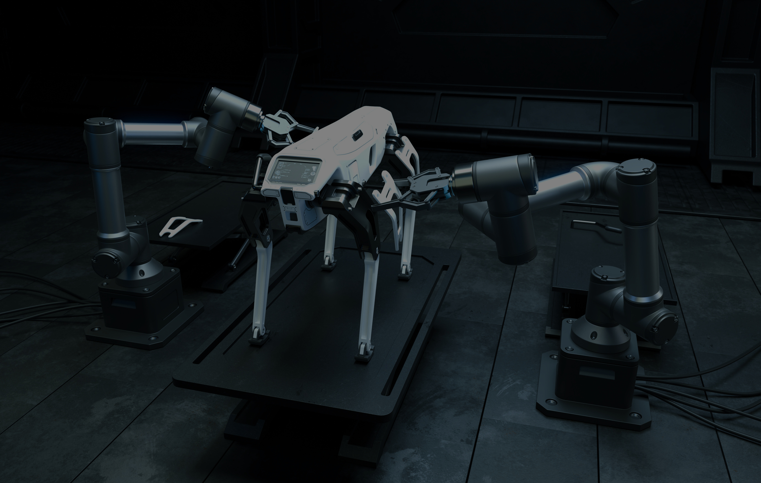

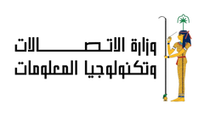

PREDICTIVE MAINTENANCE FOR INDUSTRIAL EQUIPMENT
PROJECT BY
MOHAMMED SHADY ELSAYED
AHMED OMAR
YOSSEF KHALED MOHAMED
MAHMOUD ELSAYED AHMED SAYED
TECHNICAL COMPANY: AST
SUPERVISED BY: ENG. ESLAM ELREEDY

Slide 2
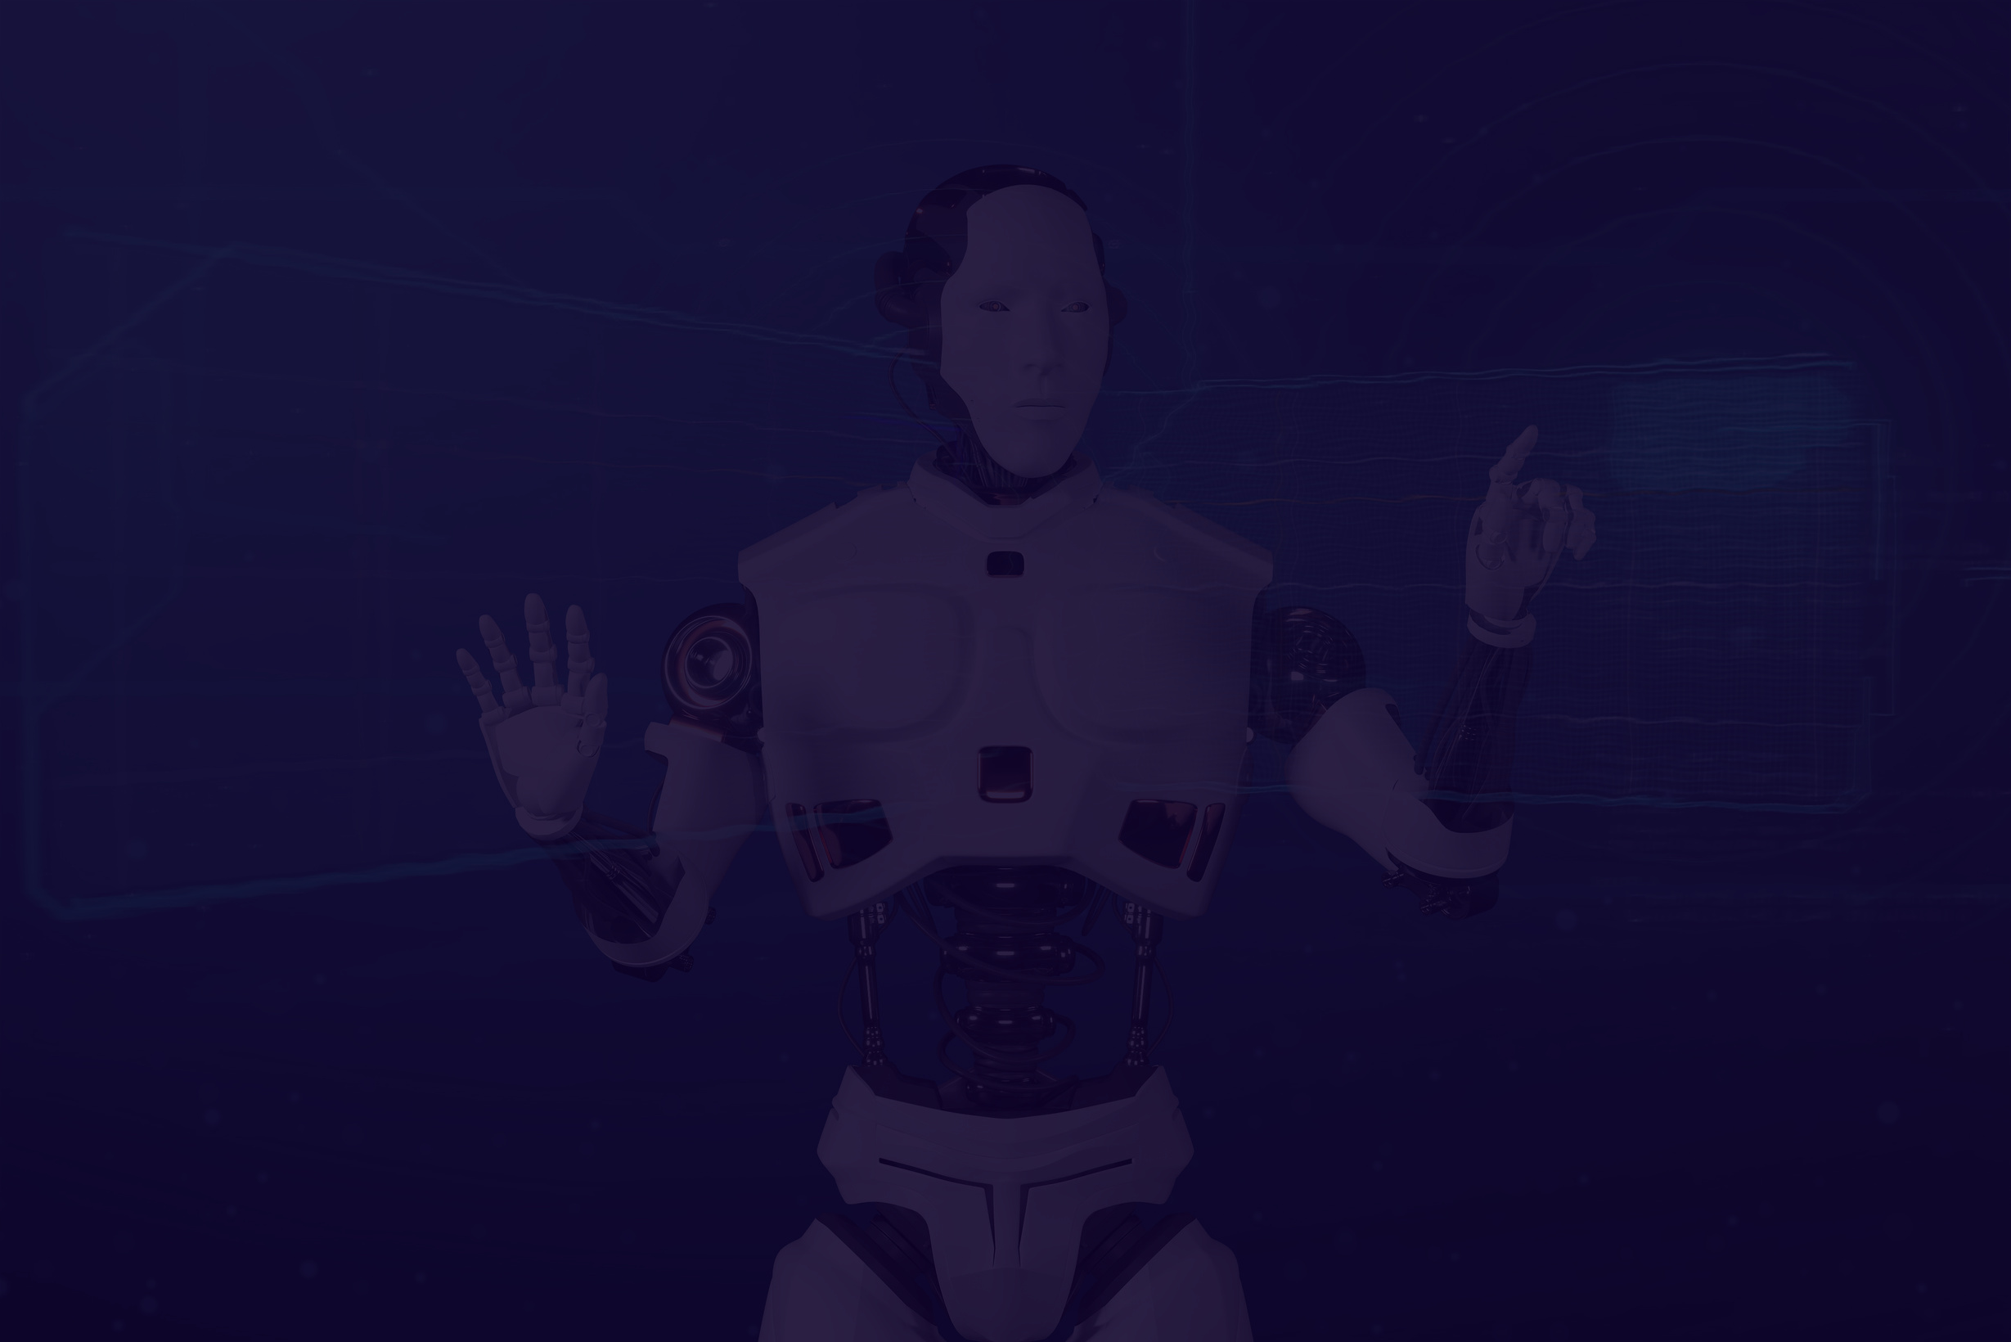
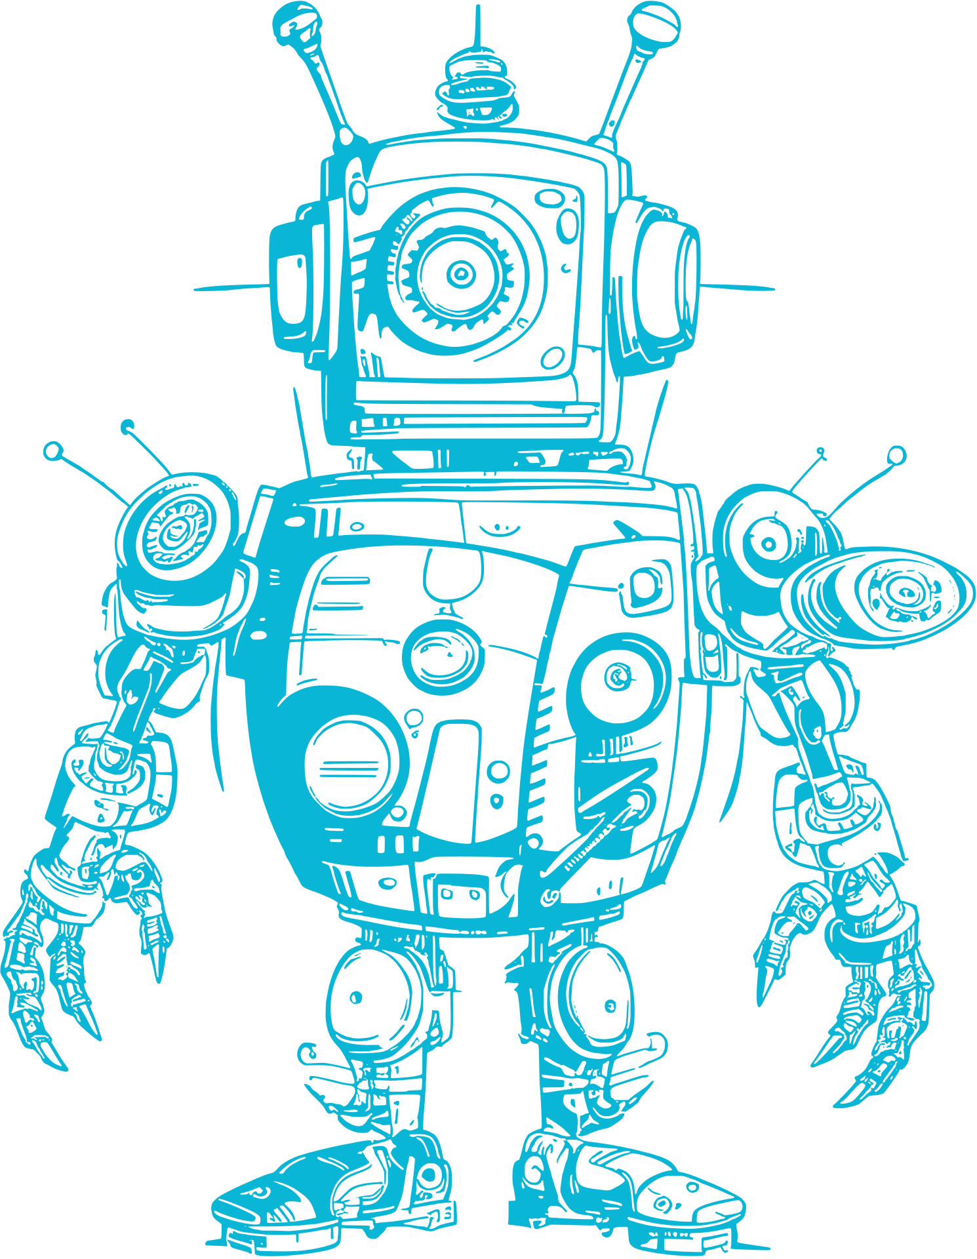

Project Overview
This project aims to develop a predictive maintenance system for industrial equipment using advanced machine learning techniques and Azure cloud services. The process involves data collection, model development, integration with Azure for real-time monitoring, and implementing MLOps to manage the lifecycle of predictive models. Additionally, Generative Adversarial Networks (GANs) will be used to simulate maintenance scenarios, ensuring a comprehensive approach to equipment failure prediction and prevention.

Slide 3


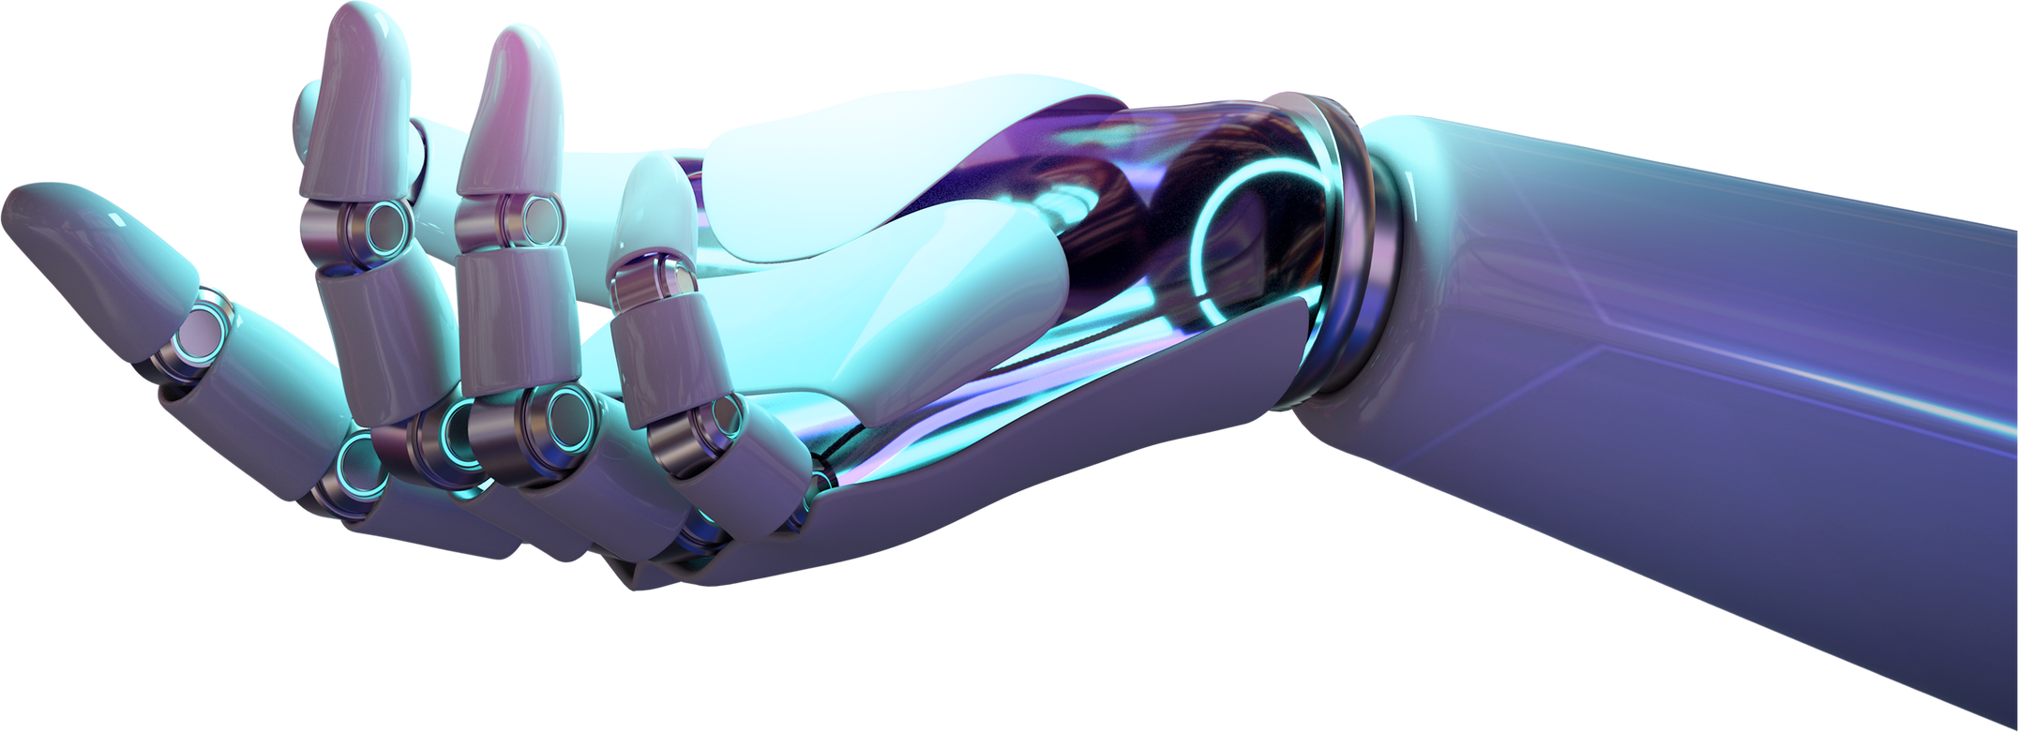
Problem Statement
In a bustling manufacturing plant, operators noticed frequent equipment failures, leading to costly downtimes. Here begin a journey to implement predictive maintenance by collecting historical maintenance logs and performance data. To uncover hidden patterns that foreshadowed equipment failures. Utilizing machine learning models, develop a system that predicted potential breakdowns, allowing the plant to perform maintenance before issues arose. This proactive approach not only saved time and money but also transformed the plant into a beacon of efficiency and reliability.

Slide 4



Methodology
Data Collection
Preprocessing
Model Selection
Gather relevant data from diverse sources.
Clean, normalize, and engineer data.
Choose and train ML/DL algorithms for peak performance.

Slide 5

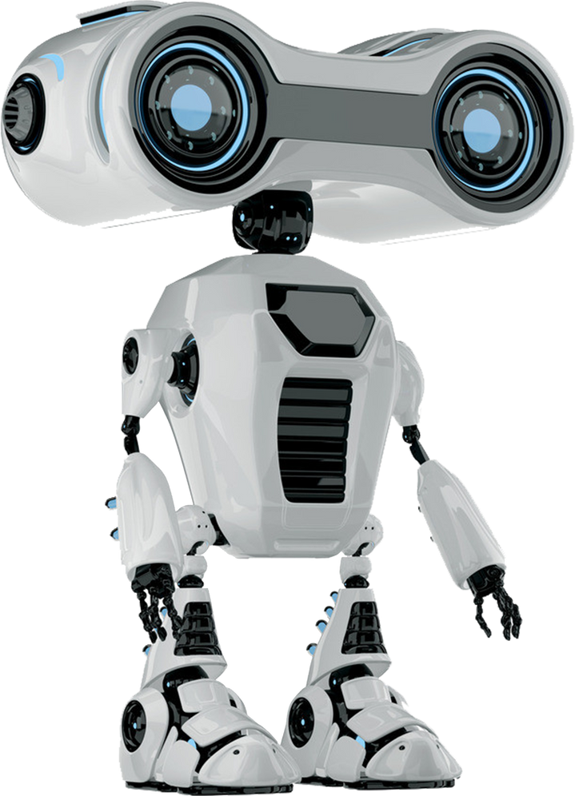
Data Collection and Preprocessing
We gather relevant datasets from various sources and clean, normalize, and preprocess the data to ensure its quality and consistency. This step is crucial for training accurate and reliable AI models.

Slide 6

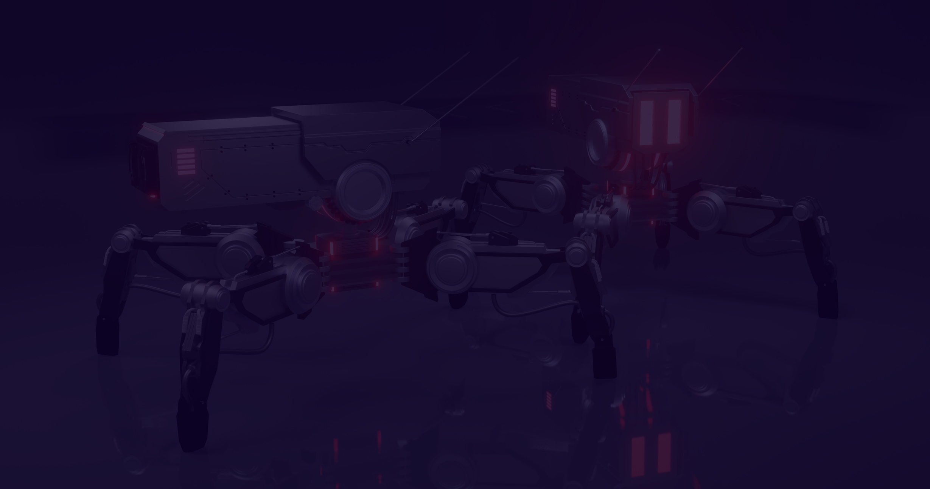

Model
Development
We design and implement machine learning and deep learning models tailored to the specific requirements of the project. This involves experimenting with different architectures, hyperparameters, and optimization techniques.

Slide 7


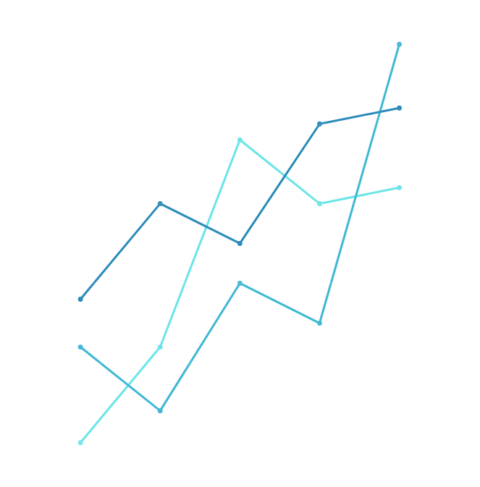
Evaluation Metrics
We define appropriate metrics to assess the performance of our AI models, such as accuracy, precision, recall, F1 score, and area under the curve (AUC). These metrics help us quantify the effectiveness of our solutions.

Slide 8


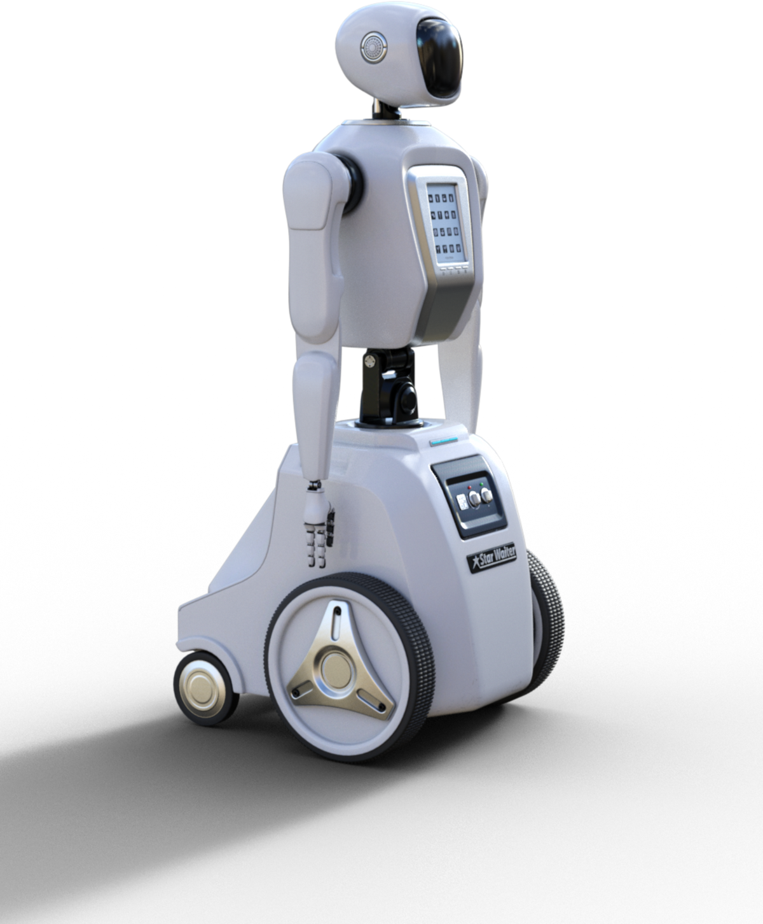
Result and Impact
We present the results of our AI project, showcasing improvements in performance, efficiency, and decision-making compared to traditional methods. We also discuss the potential impact of our solutions on stakeholders and end-users.

Slide 9
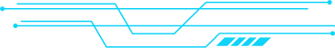

MLOPS & MLFLOW
MLOps (Machine Learning Operations) is the practice of collaboration and communication between data scientists and operations teams to help manage the production lifecycle of machine learning models.
MLflow is An open-source platform to manage the ML lifecycle, including experimentation, reproducibility, and deployment.

Slide 10

CHALLENGES WITHOUT MLOPS
Lack of version control for models.
Difficulty in deploying models at scale.
Tracking and reproducing experiments is challenging.
Manual, error-prone processes for retraining models.

Slide 11
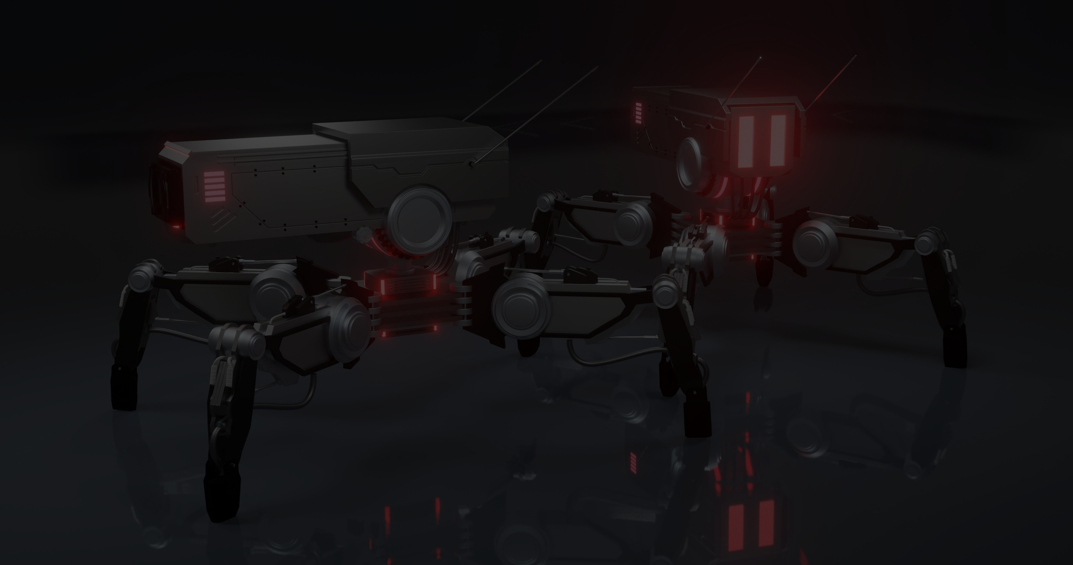

MLOPS IN OUR PROJECT
Automation: Automating the workflow for model training, validation, and deployment.
Reproducibility: MLflow tracks every experiment, making it easier to reproduce results or compare different models.
Collaboration: Helps different teams (data scientists, engineers, and operations) collaborate by providing a single platform to track and share models.

Slide 12

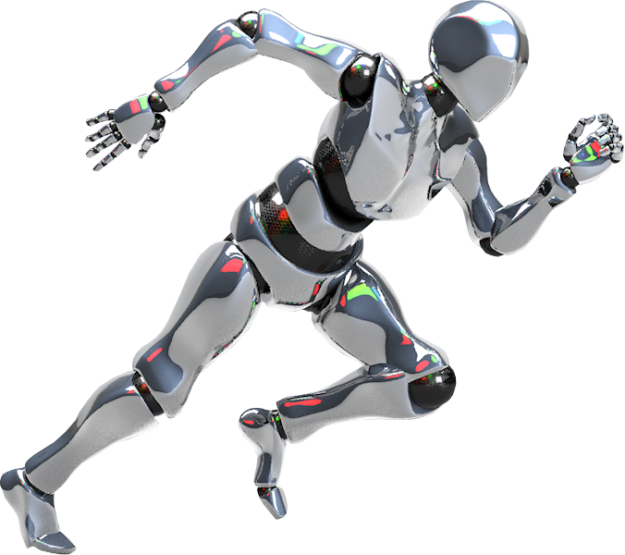
MLFLOW FOR EXPERIMENT TRACKING
Tracking Components:
Parameters: Hyperparameters like max depth for Decision Trees.
Metrics: Accuracy, confusion matrix, F1 score.
Artifacts: Visualizations (confusion matrix, feature importance), saved models.

Slide 13


GANS
the implementation of Generative Adversarial Networks (GANs), specifically utilizing Conditional GANs (CTGAN) to enhance the predictive maintenance framework. This phase aims to generate synthetic data that accurately reflects the characteristics of the original dataset, addressing issues of data imbalance and scarcity. Additionally, mode-specific normalization techniques will be applied during the training of the CTGANs to improve the quality of the generated data.

Slide 14

GANS DRAW BACKS
A fundamental challenge in optimizing deep learning models is the continuous change in input distributions at each layer, complicating the training process. Normalization methods, such as batch normalization (BN) are aimed at overcoming this issu.
Despite its great success, BN has drawbacks due to its strong reliance on the mini-batch statistics. While the stochastic uncertainty of the batch statistics acts as a regularizer that can boost the robustness and generalization of the network, it also has significant disadvantages when the estimates of the mean

Slide 15


CTGANS
The heterogeneous nature of complex datasets motivates us to propose a more flexible treatment of normalization. Before the actual normalization is carried out, the data is first organized into modes to which it likely belongs. To achieve this, we reformulate the normalization in the framework of mixtures of experts (MoE).

Slide 16
AZURE MODEL DEPLOYMENT
Azure Model Deployment allows you to deploy machine learning models as scalable APIs or services, making them accessible for real-time inference or batch predictions.
Train and Register Models
Deploy Models
Monitor & Manage Models

Slide 17




DEPLOYMENT STEPS
Create
Resource Group
Create
Machine Learning Workspace
Register Model
Deploy Realtime Endpoint

Slide 18
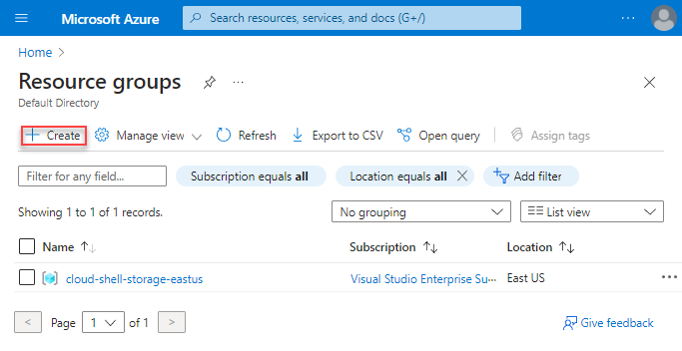
CREATE RESOURCE GROUP
container for managing and organizing related resources, allowing centralized control over policies, access, and costs.

Slide 19
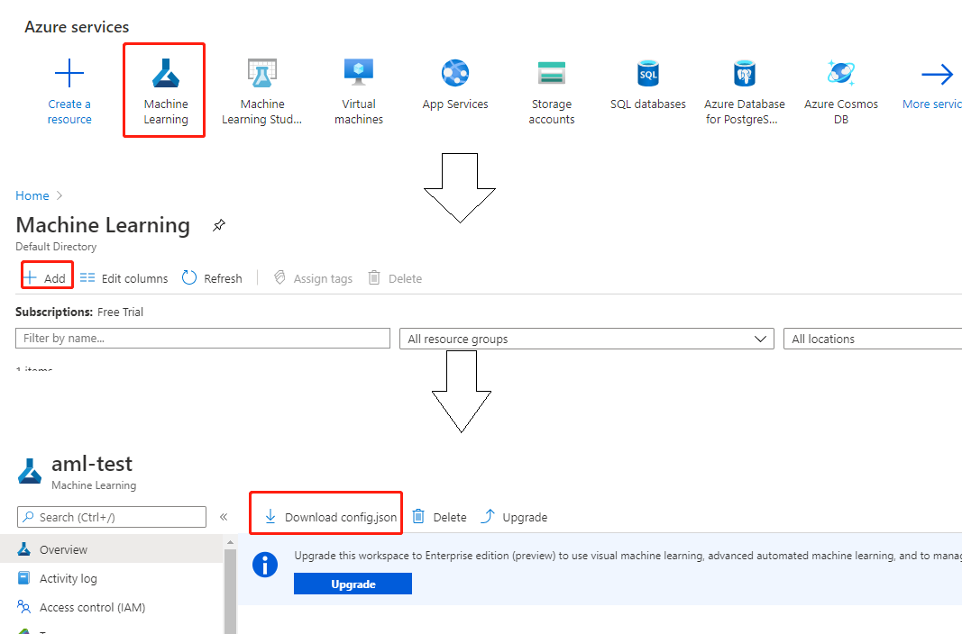
CREATE AZURE ML WORKSPACE
central environment for managing machine learning assets like models, datasets, and experiments. It simplifies collaboration, resource sharing, and tracking for data science projects.

Slide 20
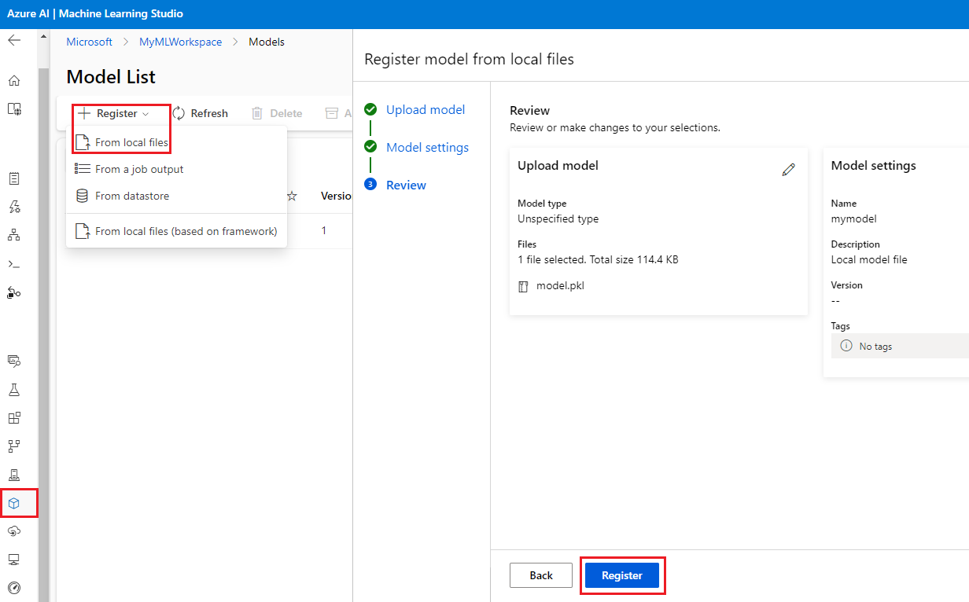
REGISTER MODEL IN WS
Register model from your local files of from other deployment services

Slide 21
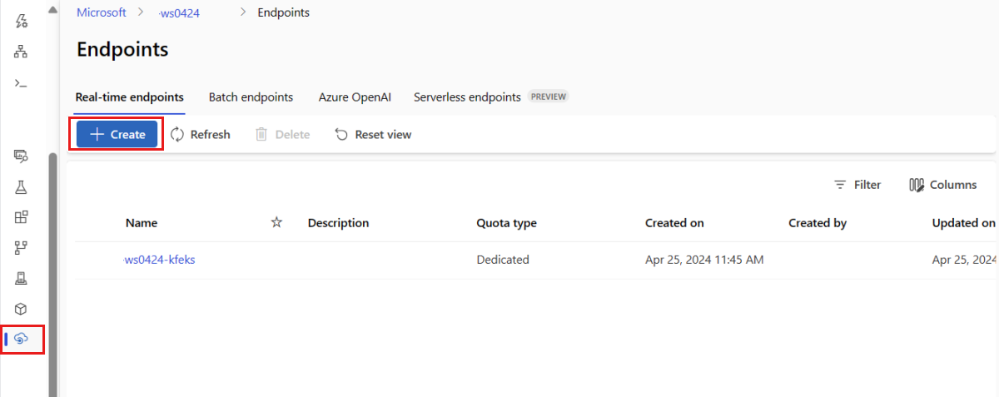
DEPLOY REAL TIME ENDPOINT
provides an API to serve machine learning models for live predictions. It allows real-time, scalable inference by exposing the model as a RESTful service.

Slide 22
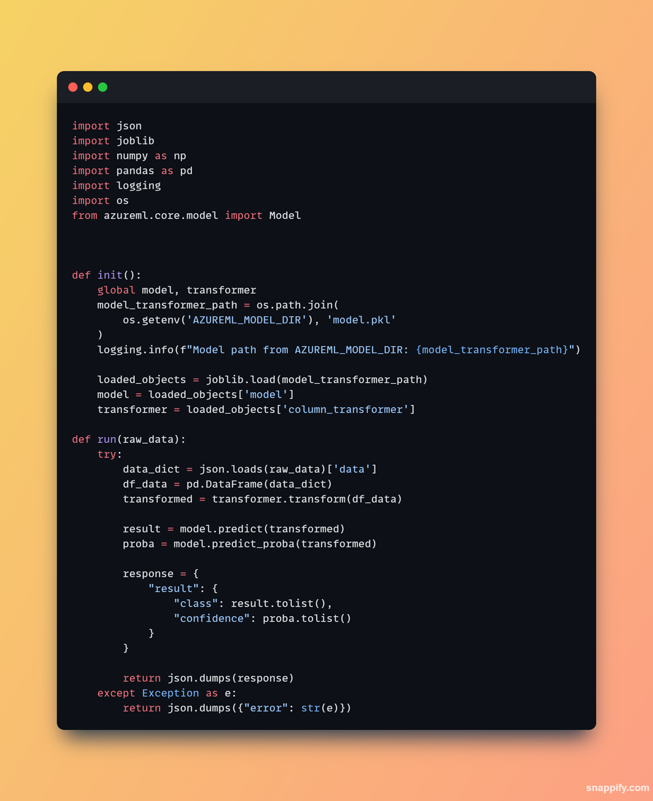
REGISTER A SCORING SCRIPT FOR THE MODEL
init()
Icalled once when the service is initialized, allowing you to load the model and any necessary resources.
run()
invoked for each incoming request, taking input data, processing it, and returning the model's predictions.

Slide 23
REAL TIME MONITORING SYSTEM
Created a simple app to monitor machine status in real time and integrated the predictive maintenance model to provide predictions for machine data.
Check current machine status
(temprature, torque, toolwear)
Control Machine
(Turn ON/OFF - Toggle Failure)
Monitor Overall System Preformance and Health

Slide 24
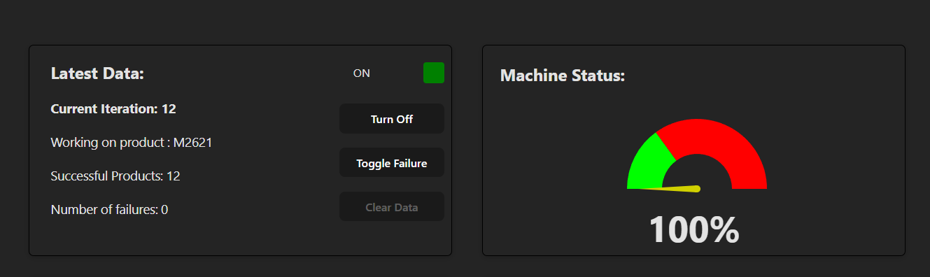
MONITOR SYSTEM PREFORMANCE
Our app provides real-time machine information, including the product name, the number of successful products, and the number of failures in the system.
It also features an overall machine status meter that measures the failure rate.

Slide 25
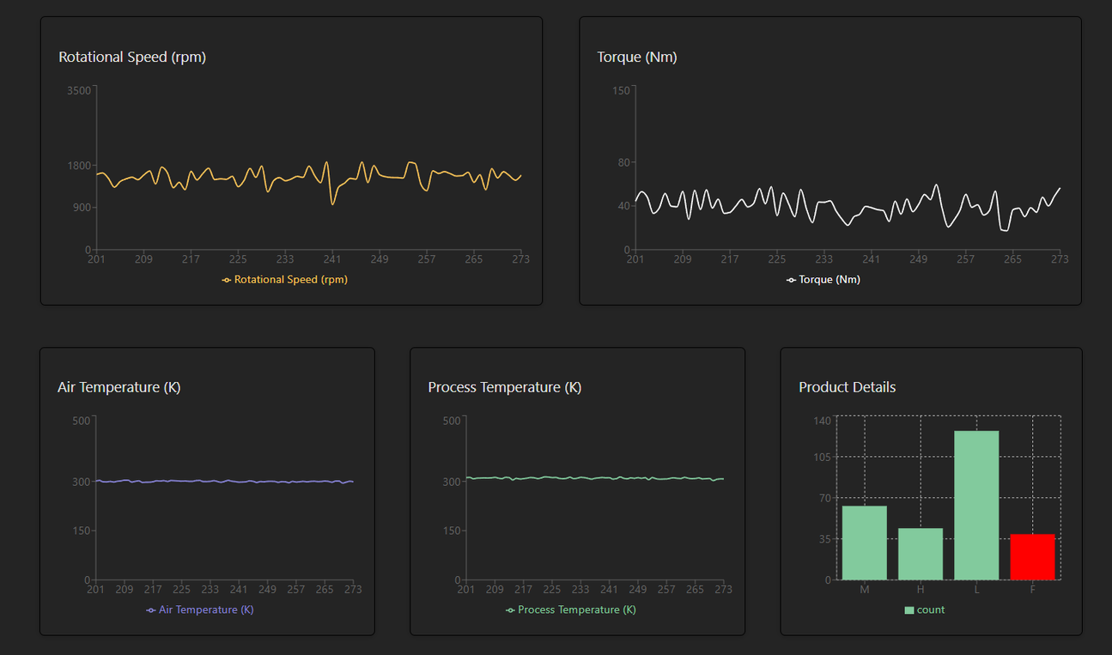
MONITOR SYSTEM PROGRESS
These graphs show real-time updates on model progress, including metrics for process temperature, air temperature, torque, rotational speed, and product counts.

Slide 26
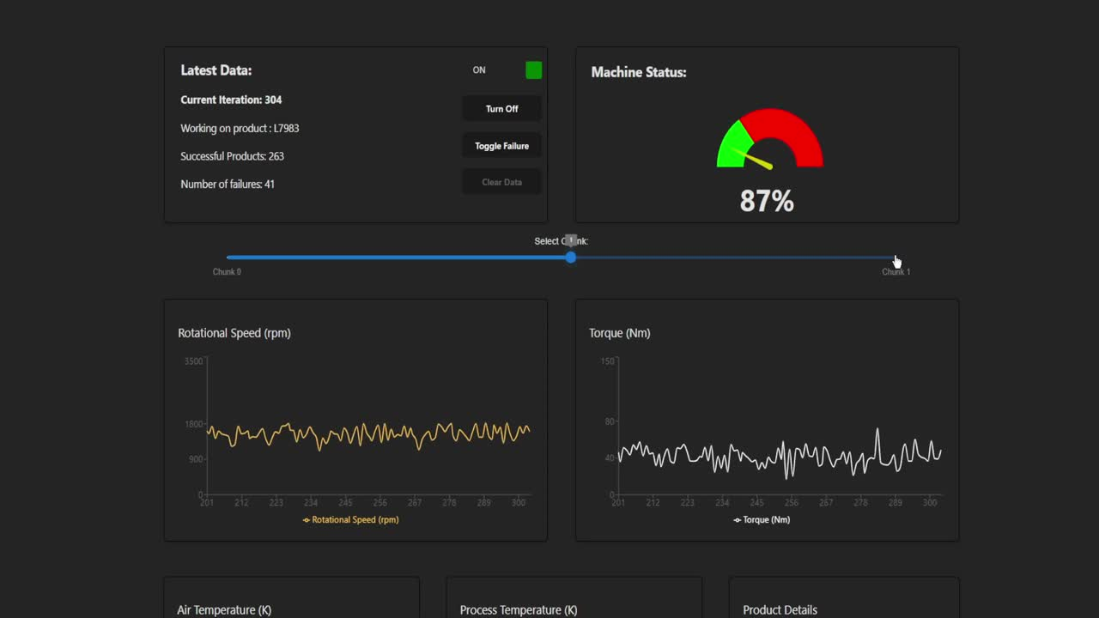
SYSTEM DEMO

Slide 27

QUESTIONS ?

